Slide 1


JAVA PROJECT
DESTINATION FILTER
ALBA SANCHEZ Luis
ARIBI Mordjane

Slide 2
PRESENTATION OF OUR PROJECT
APPLICATION WITH DATABASE
Database management
Two differents roles with different permissions

Slide 3
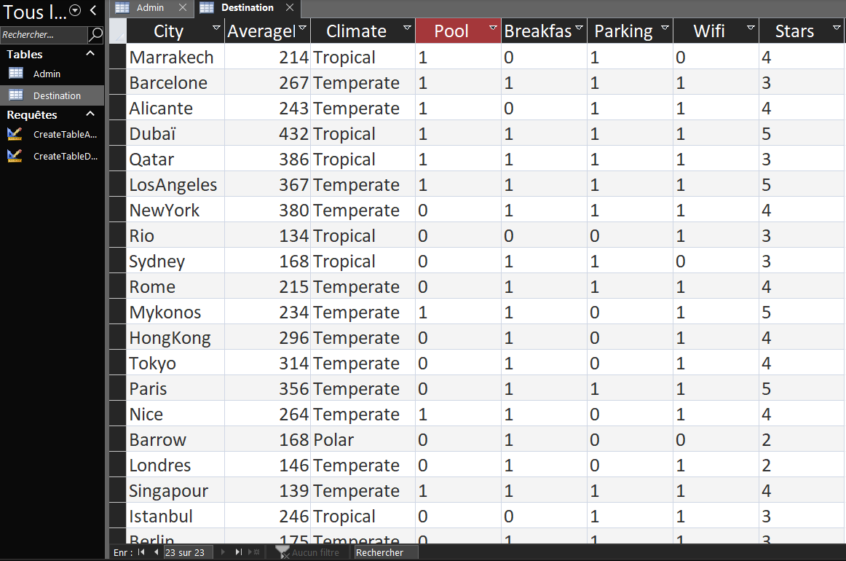
DATABASE

Slide 4
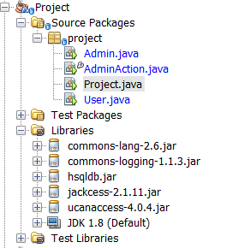
CODE ORGANIZATION

Slide 5
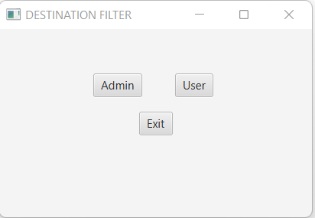
ADMINISTRATOR OR USER ?

Slide 6

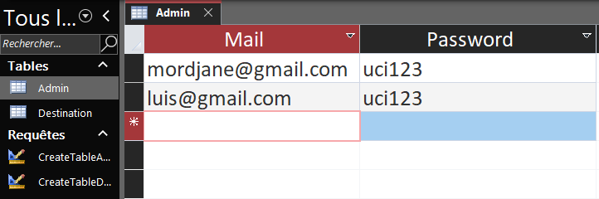
ADMINISTRATOR

Slide 7
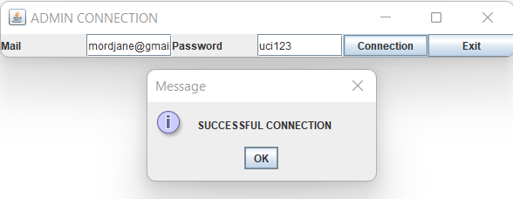
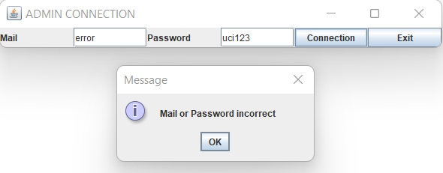
TESTS

Slide 8
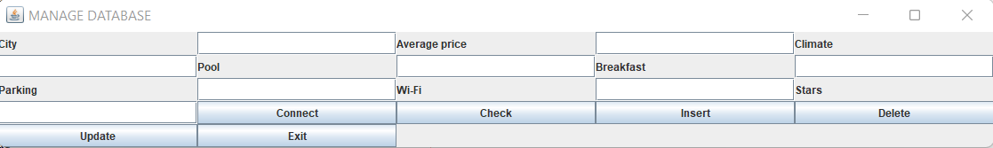
SUCCESSFUL CONNECTION

Slide 9
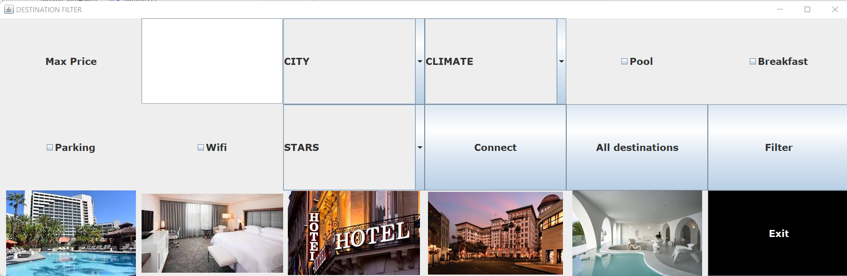
USER

Slide 10
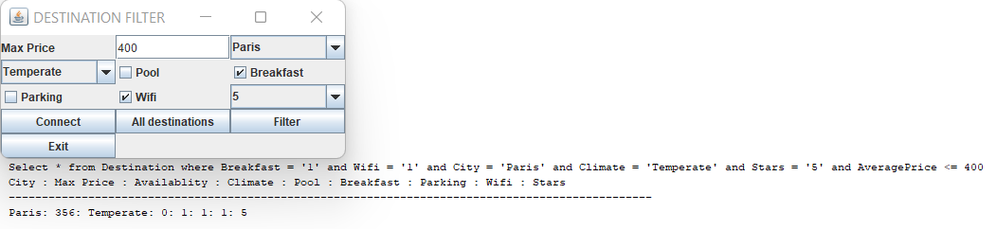
EXAMPLE

Slide 11
THE END
ALBA SANCHEZ Luis
ARIBI Mordjane

